Slide 1

Real‑Time Power Quality Event Monitoring System Using Digital Signal Processor for Smart Metering Applications
دانشجو: مهدی ملک زاده
استـــــاد: دکتر مهدی اسلامی
درس: پردازش سیگنال های دیجیتال

Slide 2
Abstract
1
Introduction
2
Proposed Real‑Time Power Quality Event Monitoring
3
Table of Contents
5
Results
Real‑Time Implementation
4
6
Discussion
7
Conclusion

Slide 3
01
Abstract

Slide 4
Due to the enormous increase of domestic and industrial loads in the smart grid infrastructure, the power quality issues are very frequent. It is essential to monitor the quality of power being supplied to customers. To identify the quality of the power effectively at various locations, a simple solution is needed that limits the usage of computing resources and can also be deployed in remote location.

Slide 5
This paper proposes a low-computational, automatic, real-time PQ monitoring system based on the Hilbert transform (HT), fuzzy logic and threshold based classifiers. The major contribution of the proposed method is based on sample-to-sample process that can detect the events timely, unlike a ten-cycle window-based methods.

Slide 6
Six power quality disturbances are synthetically generated using mathematical model as per the IEEE 1159–1195 standard. The methodology utilizes HT for the extraction of the instantaneous amplitude from the filtered signal. Thereby, the essential features are extracted and fed to classifier to improve the recognition capability. The robustness of the proposed algorithm is verified in a MATLAB environment with different signal-to-noise ratios. An experimental prototype has also been developed using TMS320F28379D Launchpad to validate the proposed PQ monitoring algorithm using both synthetic and real-time PQ signals.

Slide 7
The real-time implementation demonstrates that the proposed PQ sensing hardware and PQ disturbance analysis software are effective, fast, and accurate.

Slide 8
02
Introduction

Slide 9
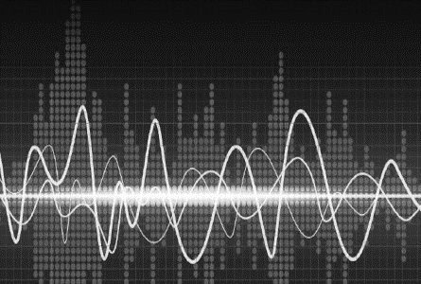
power quality monitoring
In a smart grid environment, power quality monitoring has become a critical task due to the increasing number of wide categories of disturbances. These disturbances impacts acutely a lot of domestic loads, power systems that are tightly coupled with power semiconductor devices, and many critical loads [1, 2]. Power quality disturbance (PQD) refers to deviations in either frequency or magnitude from the ideal waveform with rated parameters [2]. According to IEEE 1159–1995 [2], power quality disturbances are classified harmonics, oscillatory transients, normal, sag, swell, and interruption. Because of the numerous sources of PQ disturbances, power supply quality has become a major concern among electric power suppliers. As a result, the quality of power delivered must be continuously monitored for both electric utilities and customers. This helps in avoiding the significant financial losses and equipment damage.

Slide 10

Thus, detection and classification of PQ disturbances are highly desirable for improving the quality of service and enhancing the productivity of the systems

Slide 11
Various PQD detection and classification methods were proposed using signal processing techniques. In these methods, feature extraction is a crucial task in classifying the events correctly with high accuracy. In order to obtain more discriminant features, advanced signal processing techniques have been developed. It includes combination of time–frequency tools, adaptive mode decomposition, and deep learning techniques.

Slide 12
Analysis of PQ
Recently, the analysis of PQ events using time–frequency tools such as short-time Fourier transform (STFT), wavelet transform (WT), and s-transform (ST) have gained popularity.

Slide 13
تیتر
لورم ایپسوم متن ساختگی با تولید سادگی ک است.
adaptive decomposition algorithms
time–frequency tools
لورم ایپسوم متن ساختگی با تولید سادگی ک است.
EMD
HHT
VMD
S-transform
Wavelet transform
STFT

Slide 14
STFT
STFT utilizes a shifted window-based Fourier transform to obtain time and frequency information of the disturbance. Because of fixed window, the time resolution and frequency resolution are poor while analyzing PQ events.

Slide 15
Wavelet transform
To overcome the shortcomings, a wavelet transform has been developed with a scaled window structure to obtain time–frequency information. However, it degrades phase information in noisy conditions.

Slide 16
S-transform
The S-transform uses a scalable localized moving Gaussian window that can embed the features of both WT and STFT. It preserves localized frequency information more precisely than WT and STFT due to variable window size. It is varied according to the frequency components of the signal. Even though it provides accurate time–frequency information, due to high computational burden, the method is not suitable for real-time PQ event monitoring.

Slide 17
adaptive decomposition algorithms
On the other hand, the PQ methodologies developed based on adaptive decomposition algorithms have also gained research attention.

Slide 18
EMD
Empirical mode decomposition (EMD) is a method for analyzing non-linear and non-stationary signals. It decomposes a non-stationary signal into multiple stationary signals through a sifting process. It’s hardware implementation requires low computational resources. However, it still comprises of some issues inherently such as mode mixing leads to erroneous modes. Further, different variants of the EMD are proposed to overcome the problems in original EMD . But it suffers with huge computational complexity.

Slide 19
HHT
Hilbert Huang transform (HHT) based PQ methodologies are also investigated. It comprises basic building blocks of EMD, and Hilbert transform for extracting time and instantaneous frequency-based features. In [18], the authors developed a novel non-recursive framework based on variational mode decomposition for the PQ disturbance detection. It decomposes a complex nonstationary signal into band-limited intrinsic mode functions. It utilizes a basic building block of wiener filter, Hilbert transform, and frequency translation. It decomposes the modes precisely than EMD and HHT.

Slide 20
VMD
In contrast, the VMD requires two parameters such as bandwidth and number of modes priorly.

Slide 21
Finally, each PQD detection and classification methods have its own advantages and limitations with respect to the specific application scenarios.

Slide 22
2.1 Related Works
Recent research into smart grid PQ monitoring has been focused on developing methods for detecting and identifying PQ and getting PQ indices from the smart meters. However, most commercially available smart meters are developed for energy monitoring purposes [19]. Even though the smart grid environment is expanding, PQ detection algorithms are missing on the smart meter.

Slide 23
In [8], the authors proposed a framework for power quality disturbances using different deep learning techniques with the STFT. In this framework, seven power quality disturbances are detected using LSTM, CNN, CNN-LSTM. The authors reported results in the PC environment with the validation accuracy of 79.14% for LSTM, 84.58% for CNN, and 84.76% for CNN-LSTM, 83.66% for the CNN-LSTM with tuned hyperparameters.

Slide 24
In [12], an online PQ event detection and identification system has been proposed based on the S-transform and ANN-based classifier. Furthermore, a hardware setup has been used for collecting real PQ data using NI-cDAQ and classifying PQ disturbances on the PC environment.

Slide 25
In [16], Liu et al. proposed an ensemble empirical mode decomposition and rank wavelet support vector machine based classification method for multiple PQ events on the real-time digital simulator (RTDS) platform.

Slide 26
In [17], Sahani et al. proposed the Hilbert Huang transform and weighted bi-directional extreme learning machine classification system. It uses the four simple features for identifying the PQ disturbances. Further, a hardware setup is developed for real-time power quality monitoring using TMS320C6713. However, by using these algorithms on the smart meter, the financial burden increases for PQ monitoring at various locations.

Slide 27
In [21], the authors proposed two parallel stage VMD for identifying PQ disturbances with a decision tree. The proposed method uses four simple features for classifying 14 PQ disturbances and obtains a classification accuracy of 99.46%.For a PQ signal duration of 200 ms, the method reported a computational time of 180 ms. The authors demonstrated a hardware setup for detecting real PQ signals based on RTDS that utilizes a parallel processing block which is not available in low-end devices.

Slide 28
In [22], nine efficient features are extracted from the two-level decomposition of a discrete wavelet transform. The methodology is combined with support vector machine to identify the four PQ disturbances in the PQ signal.
It is developed for smart meter applications and have the following features: lightweight, fast, and low-computational resources.
In addition, it achieves an acceptable classification accuracy of 97%.
However, the author did not report any hardware setup. To meet real-time constraint, the higher end signal processing boards are required which increase the financial burden.
Although, all these techniques are well suited for offline purposes and developed in the personal computer (PC) environment.

Slide 29
2.2 Research Gap
An extensive research is conducted on the recent PQD detection and classification methods. However, the existing works have research gaps as presented here.
Firstly, most of the methods are employed to detect more number of PQ disturbances.
However, most of the authors have not considered the real-time feasibility of the proposed framework.

Slide 30
Secondly, the implementations of the existing frameworks require high-end signal processing boards such as RTDS, TMS320C6713DSP, etc. and their performance was not studied on a low-resource computing platforms.
It is the most important factor in reducing the overall cost of smart metering.

Slide 31
Thirdly, most of the frameworks uses 10 cycles window information for identifying PQ disturbances that limits the timely PQ events detection.
It is the most important factor in reducing the overall cost of smart metering.

Slide 32
Finally, since the computational resources are limited in low-cost DSP boards, investigating light-weight signal processing and classification techniques is highly demanded ensuring accurate and reliable detection of primary PQ disturbances.

Slide 33
Thus, developing affordable smart metering with PQ monitoring has become more important to provide feasible PQ event information for consumers.

Slide 34
2.3 Major Contributions
The goal of this paper is to develop a real-time signal processing algorithm with lower complexity for PQ event monitoring in a smart meter application.
In this aspect, a new PQ methodology has been developed with Hilbert transform method that uses a sample-to-sample process for the disturbance detection.
The proposed framework consists of digital filtering, Hilbert transform, feature extraction, fuzzy classifier, and threshold-based classifier.
The methodology can detect and classify the PQ events into normal, swell, sag, interruption, harmonics, and oscillatory transients.

Slide 35
The proposed PQ framework is implemented on the TMS320F28379D Launchpad computing platform to demonstrate the real-time feasibility of the proposed PQ monitoring system along with various simulation studies in MATLAB. The real-time system is built around the Launchpad board that is interfaced with PQ data acquisition hardware and a visualization interface on a PC to display power line waveform and PQD information.
The experimental results demonstrate that the proposed real-time PQ monitoring system is suitable for industrial and domestic smart metering with continuous PQ event monitoring for timely detection of power quality disturbances.

Slide 36
The major contribution of the presented work includes developing a lightweight, sample-to-sample, and real-time PQ event monitoring system and designing the low-cost hardware setup for the PQ event detection.

Slide 37
The main features of the proposed PQD algorithm are as follows
Proposed a lightweight signal processing technique for detecting and classifying power quality events using Hilbert transform.
This approach adequately depicts the nature of six PQ events with four simple and essential features.
The suggested method can accurately recognize and categorize PQ events in a noisy and noise-free environment.
This paper demonstrates the implementation and real-time feasibility of the proposed technique on a hardware platform. It compares with a standard fluke power analyzer to show the performance superiority in terms of the magnitude and duration of the events.

Slide 38
03
Proposed Real‑Time Power Quality Event Monitoring

Slide 39
3.1 PQD Database Creation
The PQ database has been generated using mathematical models and simulated in the MATLAB platform.
These numerical models are created according to the IEEE 1159–1995 standard, and they closely depict the real PQ disturbances.

Slide 40
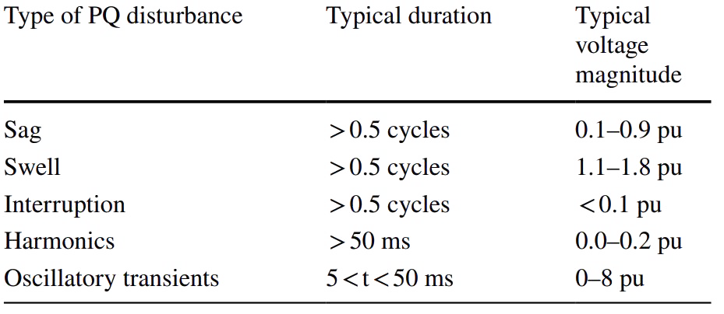
Typical characteristics of the PQ disturbances

Slide 41
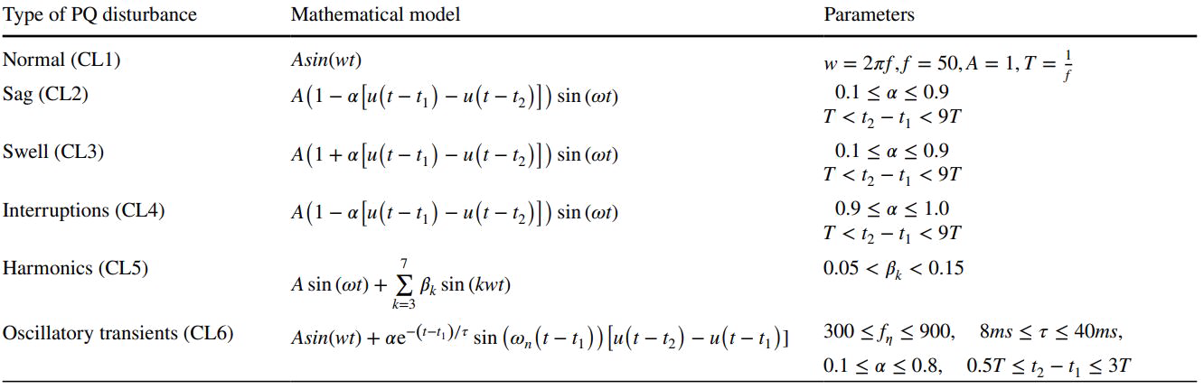
Summarizes the mathematical models and their parameters used for generating different kinds of PQD signals

Slide 42
3.2 PQD Detection and Classification Methodology
The proposed power quality disturbance detection and classification algorithm shown in Table 3 and it consists of the following three major stages:

Slide 43
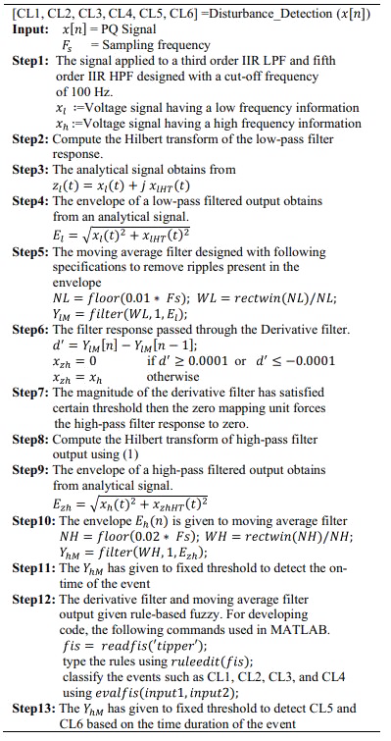
1) Digital Filtering for Waveform and Transient Events 2) Analytical Waveform and Feature Extraction 3) Classifier
Three major stages:

Slide 44
3.2.1 Digital Filtering for Waveform and Transient Events
this paper presents a traditional filtering structure used to obtain the waveform distortions and transient events. The third-order Butterworth low-pass filter is designed with a higher cut-of frequency of 100 Hz to extract waveform variations and suppress high-frequency components.
The IIR based low-pass filter is chosen instead of fir based low-pass filter due to its better response at the smallest order.
Also, it provides a minimal phase delay which reduces the detection time of the proposed framework.
The order of the IIR low-pass filter is chosen by conducting repetitive experiments that minimizes phase delay and should not affect the filter response.
Similarly, the fifth order Butterwort high-pass filter is designed with the cutoff frequency of 100 Hz.
The filter order is chosen such that it completely removes the fundamental 50-Hz component.

Slide 45
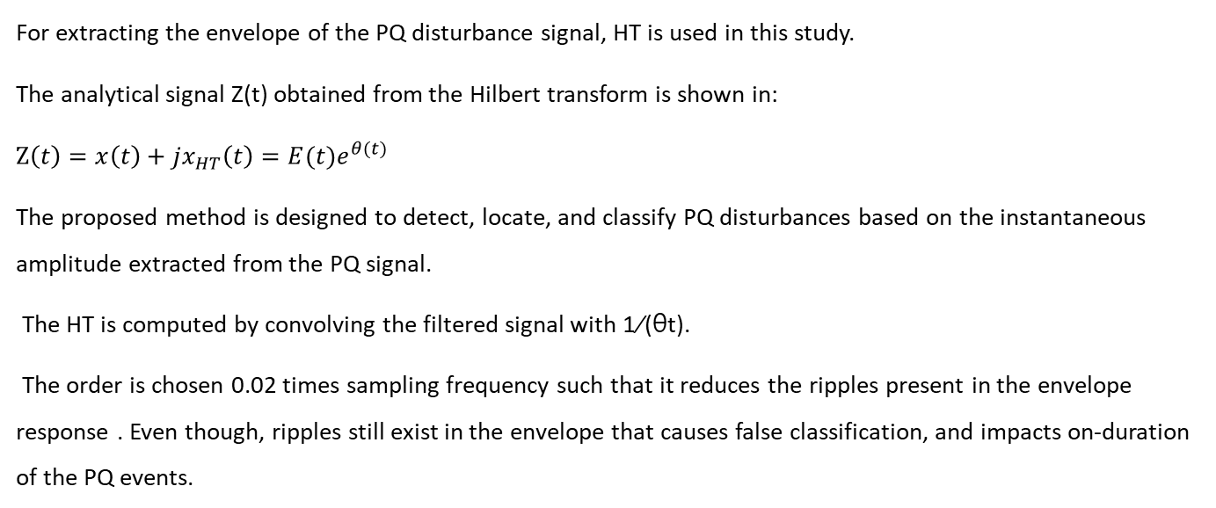
3.2.2 Analytical Waveform and Envelope Extraction
For extracting the envelope of the PQ disturbance signal, HT is used in this study.
The analytical signal Z(t) obtained from the Hilbert transform is shown in:
$$Z\left(t\right)=x\left(t\right)+jx_{HT}\left(t\right)=E(t)e^{θ(t)}$$
The proposed method is designed to detect, locate, and classify PQ disturbances based on the instantaneous amplitude extracted from the PQ signal.
The HT is computed by convolving the filtered signal with 1∕(θt).
The order is chosen 0.02 times sampling frequency such that it reduces the ripples present in the envelope response . Even though, ripples still exist in the envelope that causes false classification, and impacts on-duration of the PQ events.

Slide 46
Moving average filter is used to smooth out the ripples present in the envelope and it is fixed as 0.01 times the sampling frequency. To determine the starting and ending points of the PQ event, the derivative filter response is computed on the smoothed instantaneous amplitude.
Finally, the derivative filter response ( d′ ) and moving average filter responses ( Ylm) are given to identify the fuzzy classifier. Similarly, the high-pass filtered response (xh) consists of oscillatory, transient components, and other high frequency component due to phase jumps. These phase jumps occur during the transition of sag, swell, and interruption events. To tackle this issue, a non-linear zero-mapping filter (xzh) has been designed. It utilizes a derivative filter response ( d′ ) in the design process. The magnitude of a derivative filter satisfies a predefined threshold, i.e. either higher than 0.001 or less than -0.001. Then, the zero-mapping unit maps the high-pass filtered signal (xh) to zero. The thresholds are chosen for the minimum magnitudes of the derivative filter during sag. However, the high frequency component still exists in the envelope response (Ezh) It is further reduced using moving average filter and its order chosen 0.02 times sampling frequency.
Finally, the response is given to threshold unit to classify the PQ events.

Slide 47
3.2.3 Classifier
The fuzzy logic framework is widely used for solving physical problems.
In general, these problems are either do not govern a proper mathematical model or very complicated to encode data.
Therefore, a set of rules is framed based on human ability and includes knowledge-based information about the system.

Slide 48
The superiority of fuzzy logic (FL) systems strongly depends on the knowledge of human experts for the specified application; hence, it is only as good as the legitimacy of the rules.
In this stage, the FL framework is implemented for classifying the PQ events based on voltage variations present in the PQ signal.
With two inputs, one output, and 12 rules, a Mamdani type fuzzy inference system is created.
For the fuzzification process, one input signal is considered from the instantaneous amplitude (IA) of the signal, while the other is taken from its derivative amplitude (DA).
The envelope signal amplitude has been categorized into four trapezoids, indicated as follows: large amplitude (LA), normal amplitude (NA), small amplitude (SA), and very small amplitude (VSA).
The boundaries of the envelope signal is considered as per the IEEE 1159 standard.
In the same way, the derivative amplitude is divided into three trapezoids, each with its own label: positive derivative (PD), zero derivative (ZD), and negative derivative (ND).
The boundaries of the derivative filter are framed by considering all the possibilities of the derivative amplitudes for the PQ disturbances.
The fuzzy response (FR) has been divided into four trapezoids: swell, normal, sag, and interruption. The membership function for the IA, DA, and FR have shown in Fig. 1.

Slide 49
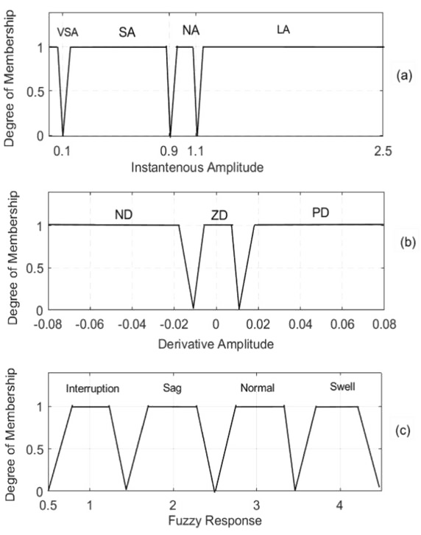
Fig. 1 Membership functions for the a Instantaneous amplitude, b Derivative, and c output

Slide 50
The rules are considered as follows:
If (IA is VSA) and (DA is ND), then (FR is interruption).
If (IA is VSA) and (DA is ZD), then (FR is interruption).
If (IA is VSA) and (DA is PD), then (FR is sag).
If (IA is SA) and (DA is ND), then (FR is sag).
If (IA is SA) and (DA is ZD), then (FR is sag).
If (IA is SA) and (DA is PD), then (FR is normal).
If (IA is NA) and (DA is ND), then (FR is normal).
If (IA is NA) and (DA is ZD), then (FR is normal).
If (IA is NA) and (DA is PD), then (FR is normal).
If (IA is LA) and (DA is ND), then (FR is normal).
If (IA is LA) and (DA is ZD), then (FR is swell).
If (IA is LA) and (DA is PD), then (FR is swell).

Slide 51
To detect harmonics and oscillatory transients, a threshold-based classifier has been designed.
In this method, the fixed threshold has been set as the maximum magnitude response of the moving average filter obtained in the swell case.
It tracks the on-duration of these events.
The duration of the event is determined as the time during which the envelope continuously exceeds the magnitude threshold level
Finally, the duration of an event is used for identifying the oscillatory transients (5 ms<DT50 ms) according to the IEEE 1159–1195 standard.

Slide 52
04
Real‑Time Implementation

Slide 53
4.1 Hardware Setup

Slide 54
Launchpad
The signal processor board used in this work is the TMS320F28379D Launchpad.
The Launchpad has two 32-bit floating-point processors, and each processor runs with a 200 MHz clock.
The selection of this board is made due to its internal subsystems such as the Floating-point unit, Trigonometric math unit, and Viterbi/Complex math unit.
These subsystems are greatly enhancing the performance of the DSP board in terms of handling much more computations.
Some of the specifications of the Launchpad include 24 enhanced pulse width modulation (EPWM) channels, three 12-bit digital-to-analog (DAC) modules, and four analog-to-digital (ADC) modules.

Slide 55
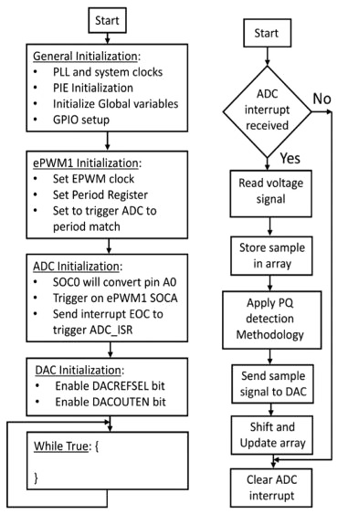
4.2 Development of Algorithm

Slide 56
05
Results

Slide 57
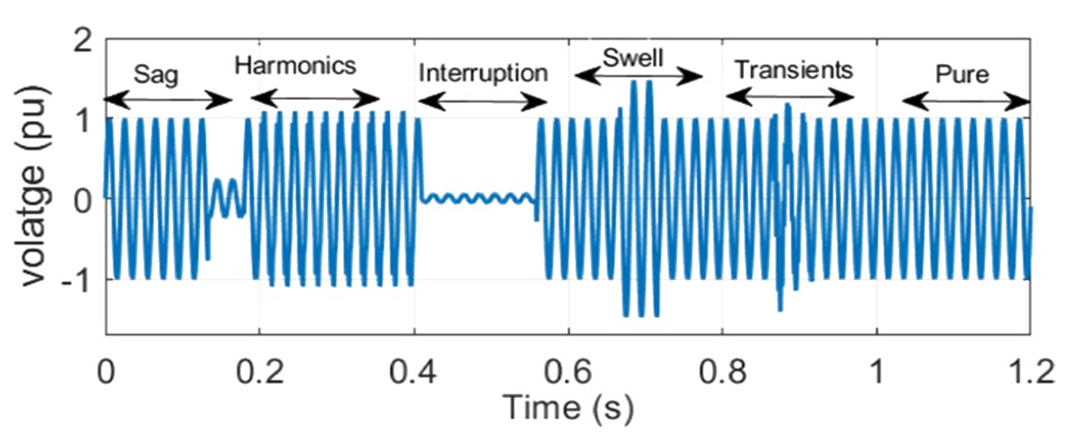
PQ signal with sag, harmonics, interruption, swell, oscillatory transients, and normal events
To detect and identify the events, the magnitude and time duration are considered for each of the signals. An example of the PQ disturbance signal is shown in Fig.

Slide 58
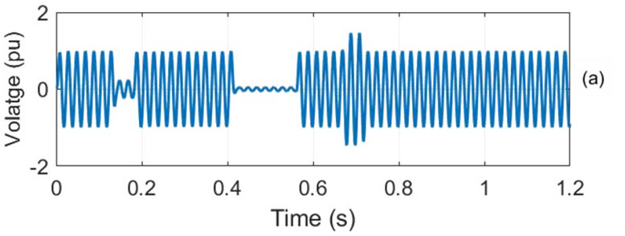
The signal is decomposed into low-frequency and high-frequency components of the disturbance via the LPF and HPF. The LPF response consists of low-frequency information such as sag, swell, interruption, and normal signal, as shown in Fig a.

Slide 59
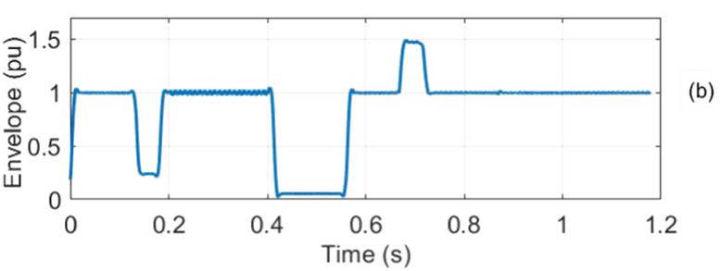
The envelope of the filtered signal is obtained from the HT, and its response is shown in Fig. b.

Slide 60
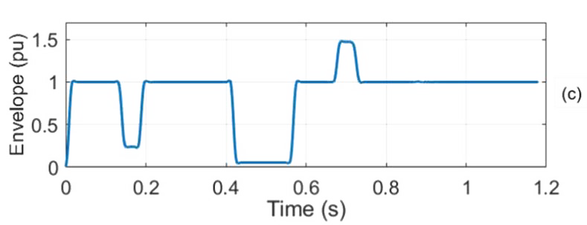
Further, the MA filter is used to reduce ripples in the envelope, and its response is shown in Fig. c. Otherwise, these ripples can cause a false classification of the events when the envelope is near the decision boundaries of swell, sag, and interruption.

Slide 61
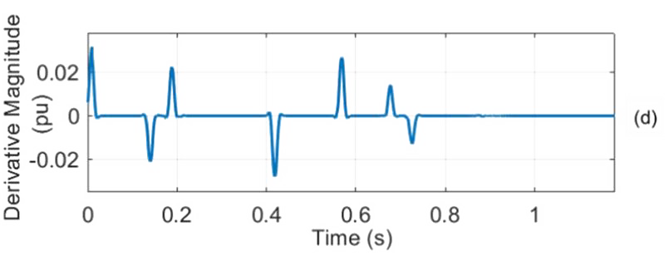
The MA filter output is given to the derivative filter to represent the starting and ending points of the disturbance, as shown in Fig. d. Now, the responses of the MA filter and the derivative filter are given to the fuzzy classifier.

Slide 62
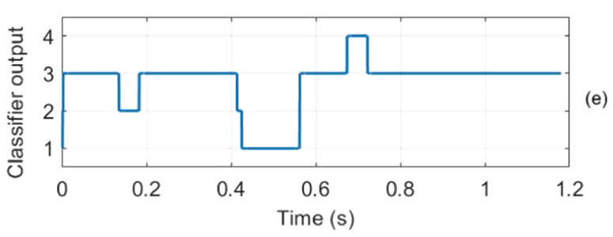
Figure e shows the fuzzy classifier response for the given PQ signal. These events are indicated with numerical numbers: one represents the interruption, two represents the sag, three represents the normal, and four represents the swell. Similarly, the high-frequency portion consists of harmonics, oscillatory events, and other events such as impulsive transients, phase jumps, and notches.
The detection capability of the proposed PQD algorithm has been restricted to only harmonics and oscillatory transients by utilizing a simple time-duration feature.

Slide 63
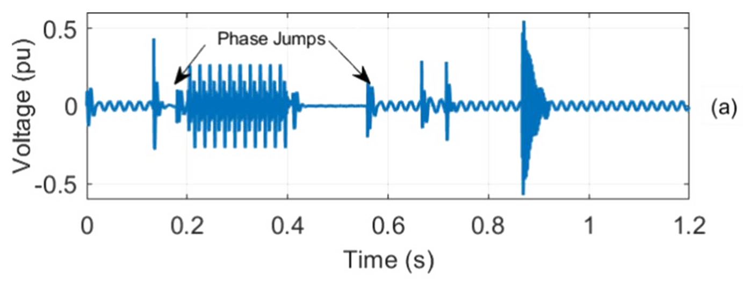
Figure a indicates the response of a high-pass filter. To nullify the phase jumps that occur due to the transitions of voltage variation events, the high pass filter output is given to a zero-mapping unit when the derivative filter magnitude is either greater than 0.001 or less than−0.001.

Slide 64
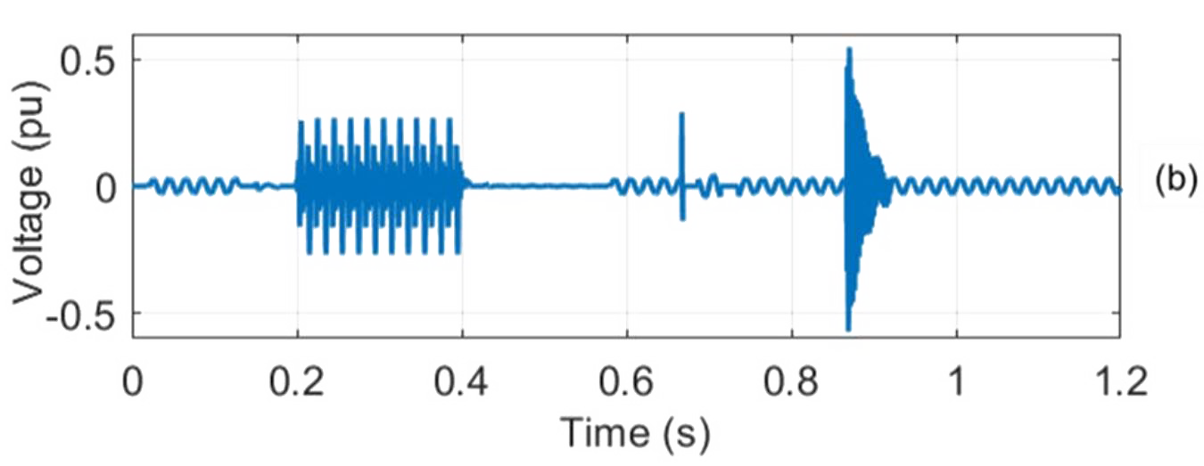
Figure b shows the zero-mapping unit response. It removes the phase jump response at different time instants, such as 0.13 s, 0.18 s, 0.41 s, 0.56 s, and 0.71 s.

Slide 65
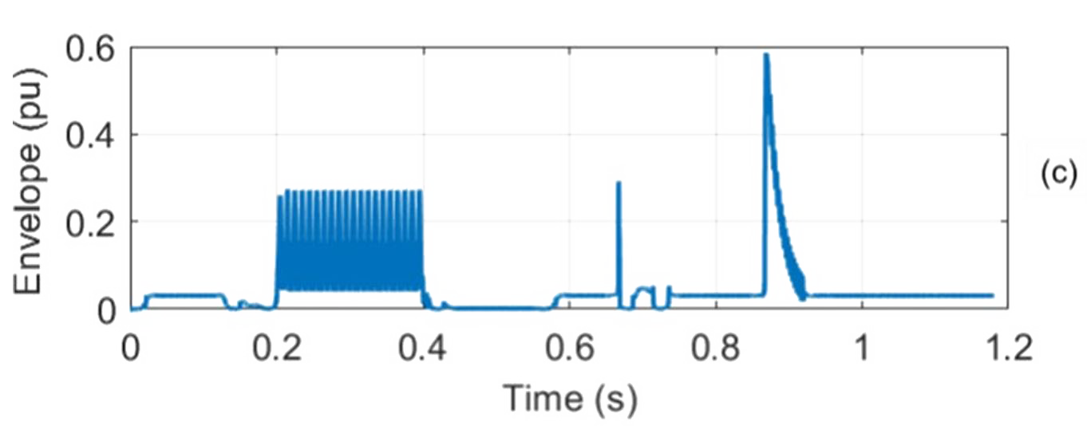
The output of the zero-mapping unit is given to HT to track the envelope of the PQ disturbance signal, as shown in Fig. c.

Slide 66
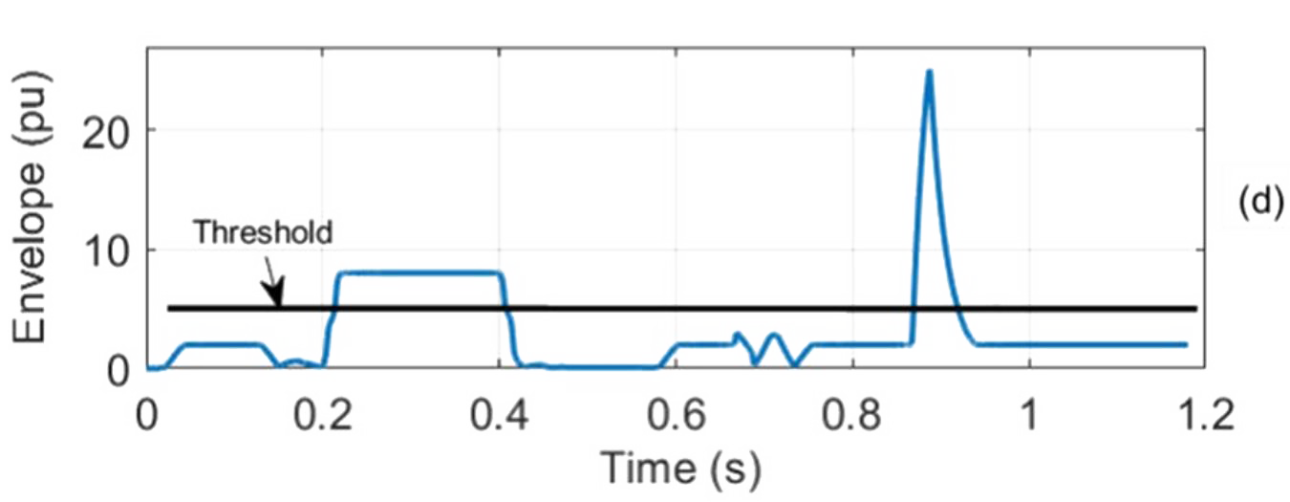
To get a smooth envelope, the PQ signal is given to the MA filter, and its corresponding response is shown in Fig. d. This filter further reduces the phase jumps in the disturbance signal.

Slide 67
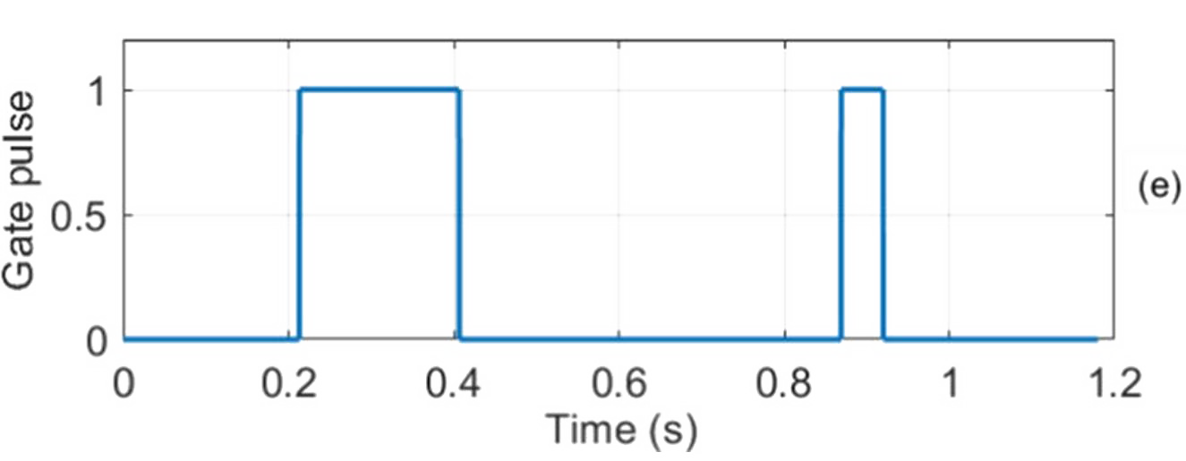
The output of the MA filter is given to the threshold unit to detect the disturbance signal duration and its response shown in Fig. 6e. The harmonic and oscillatory transients are classified based on the signal duration.

Slide 68
5.1 Classification Accuracy of the Proposed Method 5.1.1 Synthetic Signals
Initially, these PQ signals are simulated in MATLAB using numerical models according to the IEEE 1159–1195 standard, as shown in Table.

Slide 69
A total of 3000 disturbance signals are generated with the following specifications: sampling frequency of 3.2 kHz, 50 Hz fundamental frequency, and a 200 ms frame.
Finally, these disturbances, such as sag, swell, interruption, normal, harmonics, and oscillatory events, are grouped into a single signal.
In order to verify the robustness of the proposed method, the additive white Gaussian noise is added to the disturbance signals with different SNR’s of 40 dB, 30 dB, and 20 dB.

Slide 70
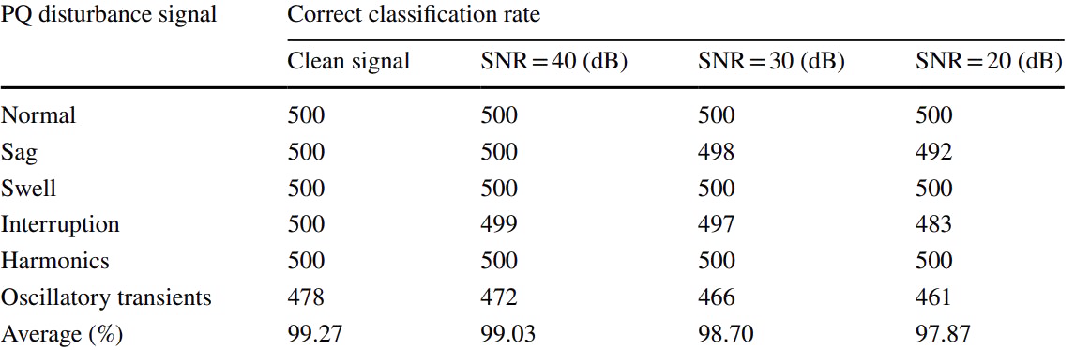
The classification accuracy of the proposed algorithm for PQ disturbance on synthetic signals

Slide 71
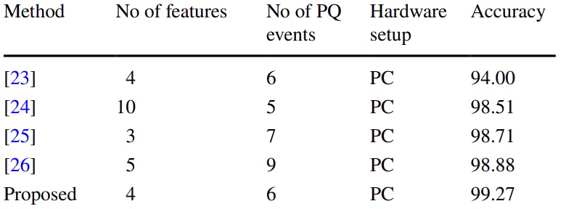
Performance comparison of existing methods
In order to show the effectiveness of the proposed method, the classification results are compared with the past studies reported in the literature, as shown in Table 5.

Slide 72
5.1.2 Real‑Time Signals
These signals are generated using a PPS as per the IEEE standard 1159–1195.

Slide 73
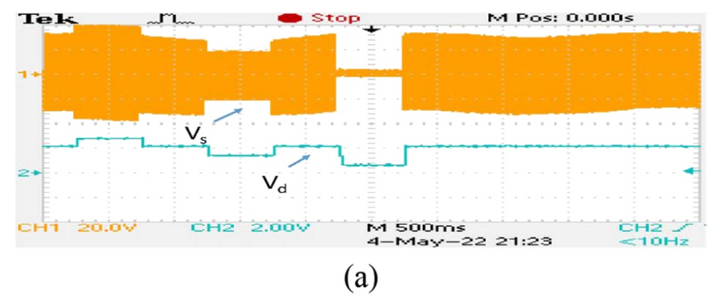
In this work, we have demonstrated results on the DSO, it consists of 0.5 s of swell, 0.5 s of sag, and 0.5 s of interruption in a pure signal denoted as VS, as shown in Fig. 7a.
The classifier response is collected from the DAC unit of TMS320F28379D Launchpad, which is denoted as Vd in Fig. a. We noticed that the method takes nearly 22 ms for detecting the normal, swell, sag, and interruption present in a PQ signal.

Slide 74
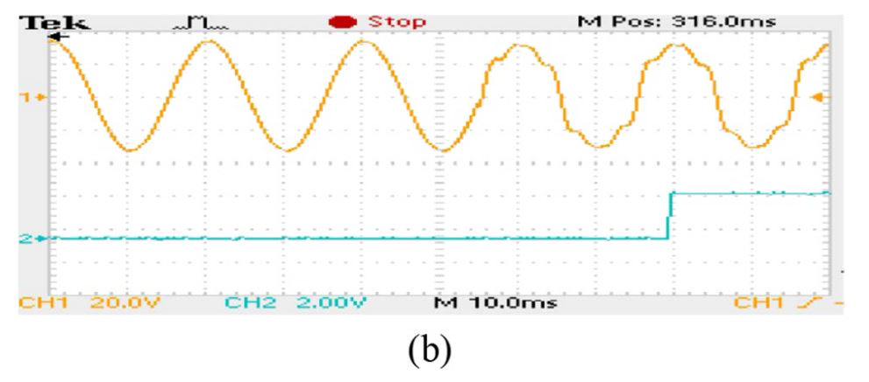
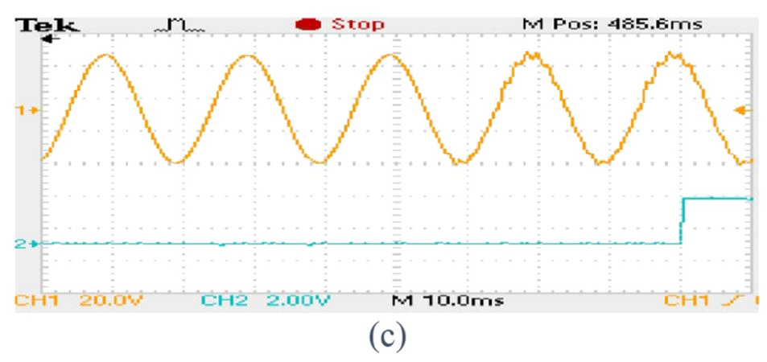
5.1.2 Real‑Time Signals
Figure b, c shows harmonics and oscillatory transients detection on the DSO, and it provides a fixed delay of 25 ms for detecting these events.

Slide 75
06
Discussion

Slide 76
The method obtains the PQ information by sample-to-sample processing,
This method utilizes Hilbert transform for envelope extraction.
The simple features are extracted from the envelope and used for classification.
The advantage of the proposed method is faster, and accurate in classification.
The sample-to-sample processing time of the proposed algorithm is less than 291 µs.
It is important to notice that the objective of the proposed algorithm has been accomplished in terms of lower complexity, and usage of low-cost devices.
Thus, this work is suitable for recording the power quality events with their corresponding magnitude and duration of the event.
The superiority of the proposed algorithm is that, it need not record the PQ events continuously.
Instead, it can record PQ events at the moment of event triggering.
This work can be extended for online mitigation of PQ events such as sag, swell, harmonics and interruptions.
Also, it can be applied to internet of things-based power quality event monitoring system by adding wireless communication protocols to the existing hardware setup.
It helps in monitoring power quality events in remote locations.

Slide 77
The main limitation of the proposed algorithm
The main limitation of the proposed algorithm is, it can only detect sag, swell, interruption, harmonics and oscillatory transients.
However, the other events such as notches, flicker etc., are also present in the power system, but their frequency of occurrence is less.

Slide 78
07
Conclusion

Slide 79
design and development of an automatic real-time PQ monitoring for timely identification of PQD information.
The PQD algorithm consists of Hilbert transform and fuzzy classifier for detection and identification of power quality events.
The simple magnitude and duration features are extracted from the filtered signal.
The proposed algorithm has been implemented on the TMS320F28379D Launchpad to show the real-time feasibility along with various simulation studies in MATLAB.
Experimental results demonstrated that the proposed real-time PQ monitoring system can automatically detect and classify PQ events into normal, swell, sag, interruption, harmonics, and oscillatory transients with classification accuracy of 90–100%.
The real-time implementation illustrates that the proposed PQ monitoring system can be integrated with smart metering for timely detection of PQ disturbances.

Slide 80
Thanks for your attention

